Slide 1
CSE 6179 Digital Forensics
Lecture 3
Computer Forensics – Part I
Chapter 5 (DF – Wiley)

Slide 2
Overview
Evidence Collection
Data Acquisition
Examination
Disk Structures
File system

Slide 3
5.2 Evidence Collection
5.2.1 Data Acquisition
Data acquisition is the act of collecting data relevant to an investigation. This data can be live data, including memory captures, or it can be collected in a forensically sound manner as an image or a forensic copy.
Live Data (Including Memory) --- Files, Memory, Volumes
Forensic Image --- A forensic image is the most common way of maintaining evidence from a computer system. In this case, an image ﬁle is created from the original source.
Forensic Copy -- A forensic copy is a copy created in blocks where every byte is copied in the block, including unallocated bytes.

Slide 4
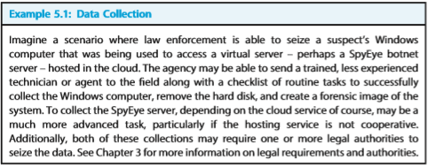
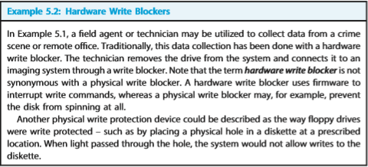
5.2 Evidence Collection (contd.)

Slide 5
5.2 Evidence Collection (contd.)
5.2.1.1 Live Acquisition (Including Memory)
Involves collecting data from a running system, including memory, mounted files such as Windows registry hives, unencrypted volumes or file systems, security files, or open processes.
Common in cases where a suspect is believed to have used full disk encryption –which means shutting down the system will remove the decryption key from memory and render the device unreadable without the correct password or key.
Files (Acquiring files utilizing a forensic tool like AccessData’s FTK imager rather than the Copy command provides better options for accountability of what was acquired, chain of custody documentation, and verification through hashing)
Memory (Acquired using software tools such as AccessData’s FTK Imager, often acquired from a running system if it’s suspected of running malware or encryption. Encryption keys may be located in memory, for example. In many cases, memory has been used to locate attacker command activities on a system as well)
Volumes (Full volumes can be acquired utilizing a tool such as AccessData’s FTK Imager that can acquire a mounted volume including unallocated space even if the volume is encrypted.)

Slide 6
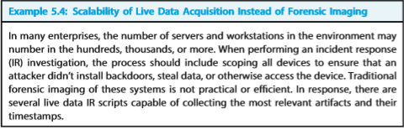
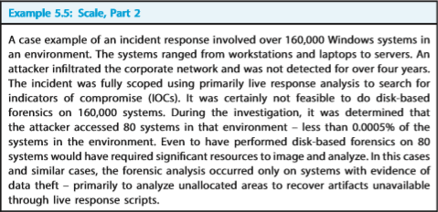
5.2 Evidence Collection (contd.)

Slide 7
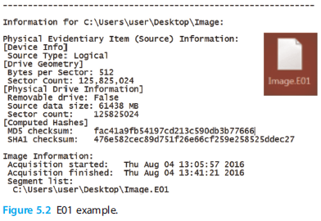
5.2 Evidence Collection (contd.)
5.2.1.2 Forensic Image
Most common way of maintaining evidence from a computer system, where an image file is created from the original source.
The image is created in blocks and every byte is copied in the block, including unallocated bytes. Not a bit-stream image or a byte-for-byte copy. The image may be stored in a flat file such as a raw “dd” image, or in a compound evidence file such as an E01 (Figure 5.2) or AD1.
Advantage to using a raw evidence file: Nearly every tool designed for analysis can read from a raw file or the file can be mounted as a disk image.
Disadvantages: the image is not compressed, it will use as much space as the original device, and linear searching can take longer to perform.
Compound evidence file advantages include the ability to segment the image into “chunks” for backup purposes or for keeping within a file system’s file size limitation. Evidence files can also be compressed and encrypted, and segments can contain checksums to help ensure validity.

Slide 8
5.2 Evidence Collection (contd.)
5.2.2 Forensic Copy
A copy created in blocks where every byte is copied in the block, including unallocated bytes.
Similar to the way a forensic image is created, but a forensic copy is created on another drive the same size or larger than the original rather than by creating an image file.
Common uses of forensic copies include cases where a system needs to be booted for various reasons such as utilizing a password to mount a volume, running software natively, or booting an uncommon OS.
The forensic copy can then be used in the system instead of the original evidence.

Slide 9
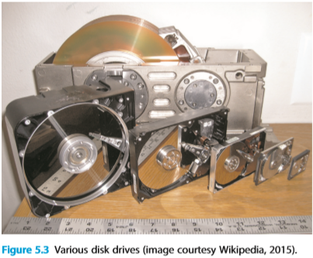
5.3 Examination
5.3.1 Disk Structures:
A disk is a device used to store and retrieve data readable by a computer system.
The means of storing the data on a medium are typically
(1) magnetic – as with a hard disk, tape drive, or ﬂoppy diskette
(2) optic – as with a CD or DVD
(3) electronically programmable memory – such as with ﬂash drives or memory cards.

Slide 10
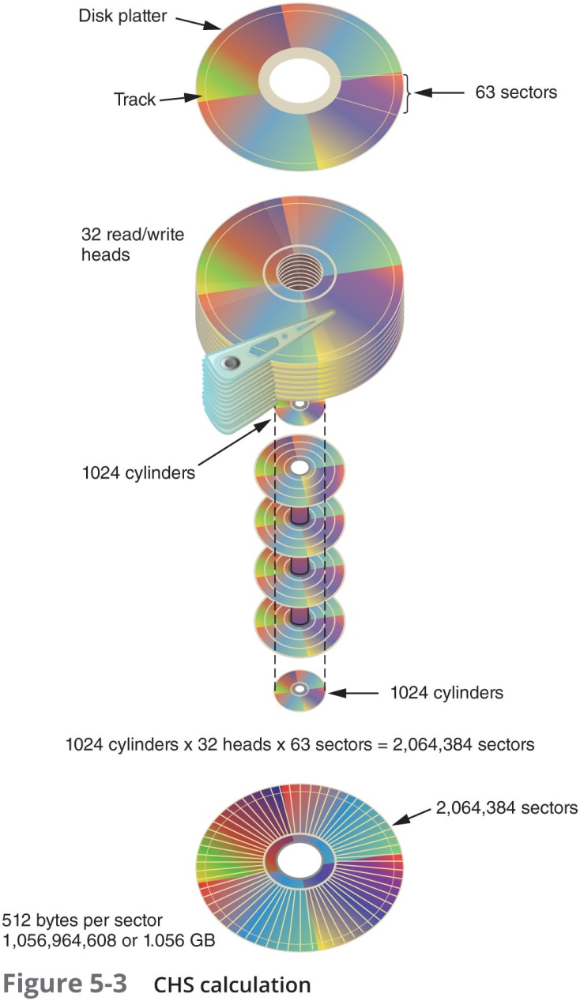
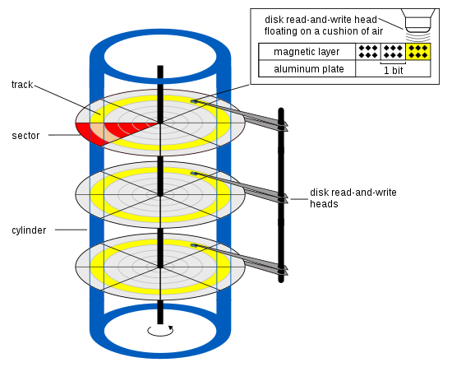


5.3 Examination (contd.)
5.3.1.1 Physical Disk Structures:
A physical drive is the entire disk device. This includes the metal housing, platters, read-write heads, motor, and electronics.
On floppy diskettes, normally one sector would equal one cluster that normally contains 512 bytes of data.
On most modern Windows systems with NTFS (New Technology File System) formatting, one cluster (by default) is often composed of eight sectors (4096 bytes, or 4Kb).
Solid-State Storage Devices:
All flash memory devices have a feature called wear-leveling
An internal firmware feature used in solid-state drives that ensures even wear of read/writes for all memory cells
When dealing with solid-state devices, making a full forensic copy as soon as possible is crucial
In case you need to recover data from unallocated disk space
CHS (Cylinder-Head-Sector) Calculation

Slide 11
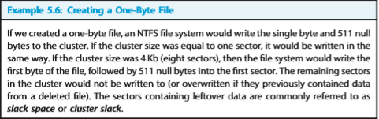
5.3 Examination (contd.)
Hexdump Analysis (Some preliminaries)
Converting Between Bases (Decimal, Binary, Hexadecimal)
0x98 to binary
Organizing multiple-byte values (Big-endian vs. Little-endian)
CHS vs Logical Block Address (LBA)

Slide 12
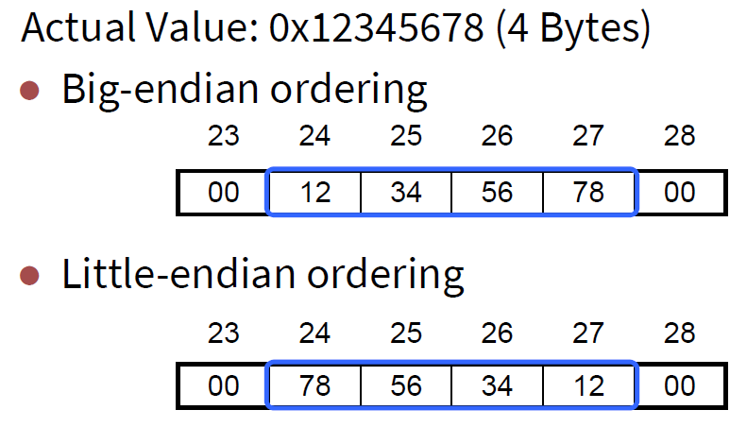
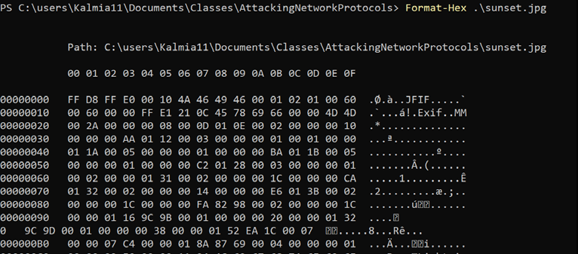
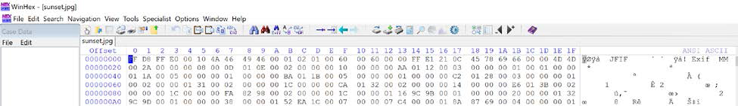
5.3 Examination (contd.)
Hexdump Analysis (Some preliminaries)

Slide 13
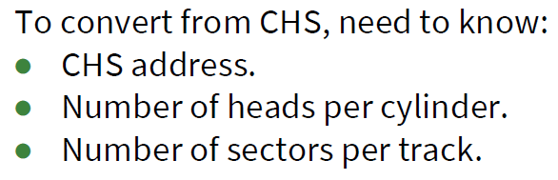
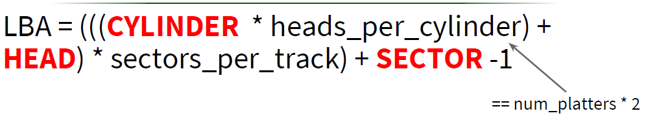
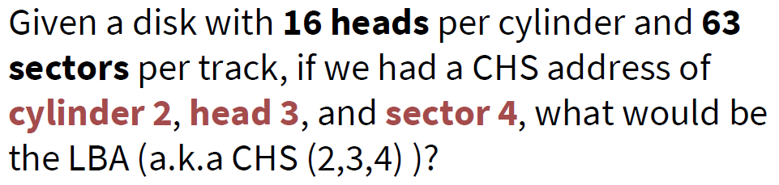
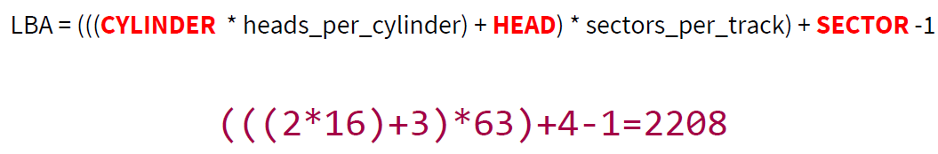
5.3 Examination (contd.)
Hexdump Analysis (CHS to LBA conversion)
Example: Address conversion

Slide 14
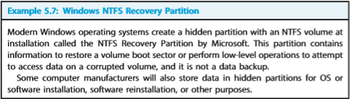
5.3 Examination (contd.)
5.3.1.2 Logical Disk Structures
Logical structures on a physical disk are required for the OS to access the storage space on the physical device.
The user must follow these steps to access the drive as storage media:
1) Create a partition table – either MBR or GPT – with a tool such as FDISK.
2) Format the partition into a logical volume that contains a ﬁle system.
3) Assign the partition a drive letter or mount point.

Slide 15
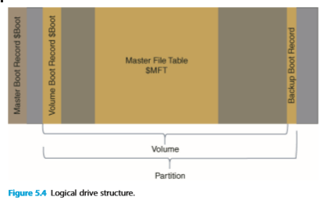
5.3 Examination (contd.)
Logical Volumes, Sectors, and Advanced Format Drives
Formerly, logical volumes could only be created on a track boundary – and volume can only start on sector 63 and multiples.
Advanced format drives include 4Kb (4096 byte) sectors, Windows 7 or greater system will place the first volume at sector 2048.
A partition is a logical drive
Windows OSs can have three primary partitions followed by an extended partition that can contain one or more logical drives
Hidden partitions or voids
Large unused gaps between partitions on a disk
Partition gap
Unused space between partitions
The partition table is in the Master Boot Record (MBR)
Located at sector 0 of the disk drive
In a hexadecimal editor, such as WinHex, you can find the first partition at offset 0x1BE
The file system’s hexadecimal code is offset 3 bytes from 0x1BE for the first partition

Slide 16
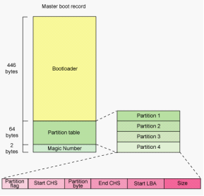
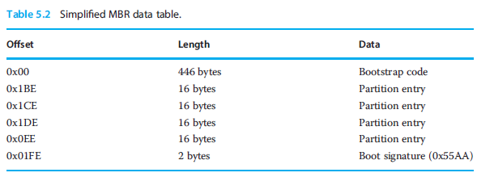
5.3 Examination (contd.)
5.3.1.2.1 Master Boot Record (MBR)
Consists of one sector –absolute sector zero
Includes the boot code, disk signature, and primary partition definitions, and ends with a signature (a two-byte code represented in hexadecimal as 0x55AA).
Earlier installations required the first partition to be created on a track boundary (track 63), while newer implementations remove this requirement and the first volume can be anywhere the MBR defines it (typically, at sector 2048 or 4096).

Slide 17
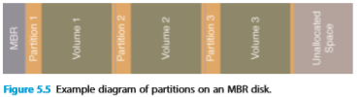
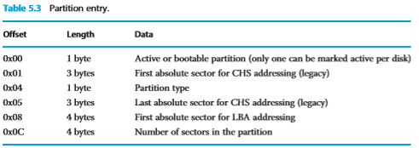
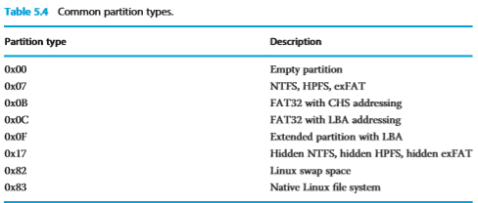
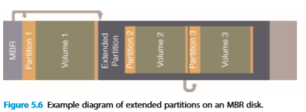
5.3 Examination (contd.)
5.3.1.2.1 MBR (contd.)
An MBR-formatted disk (Figure 5.5) can contain up to four partitions in the boot record (Table 5.3 for a partition entry and Table 5.4 for common partition types) all of which can be primary and only one of which can be an extended partition.
A primary partition can contain one and only one volume, and only one of these volumes can be bootable (an extended partition cannot be natively bootable).
An extended partition (Figure 5.6) can contain additional logical partitions. The first defined logical partition utilizes the volume boot record (VBR) to define itself and the next logical partition. This continues as a linked list until the final logical partition defines only itself.
Problems for a digital examiner: 1) A person wanting to hide data could manually edit the partition table and skip a partition by pointing to the next partition in the link. 2) If a partition in the chain becomes corrupted, all subsequent partitions have no definition.

Slide 18
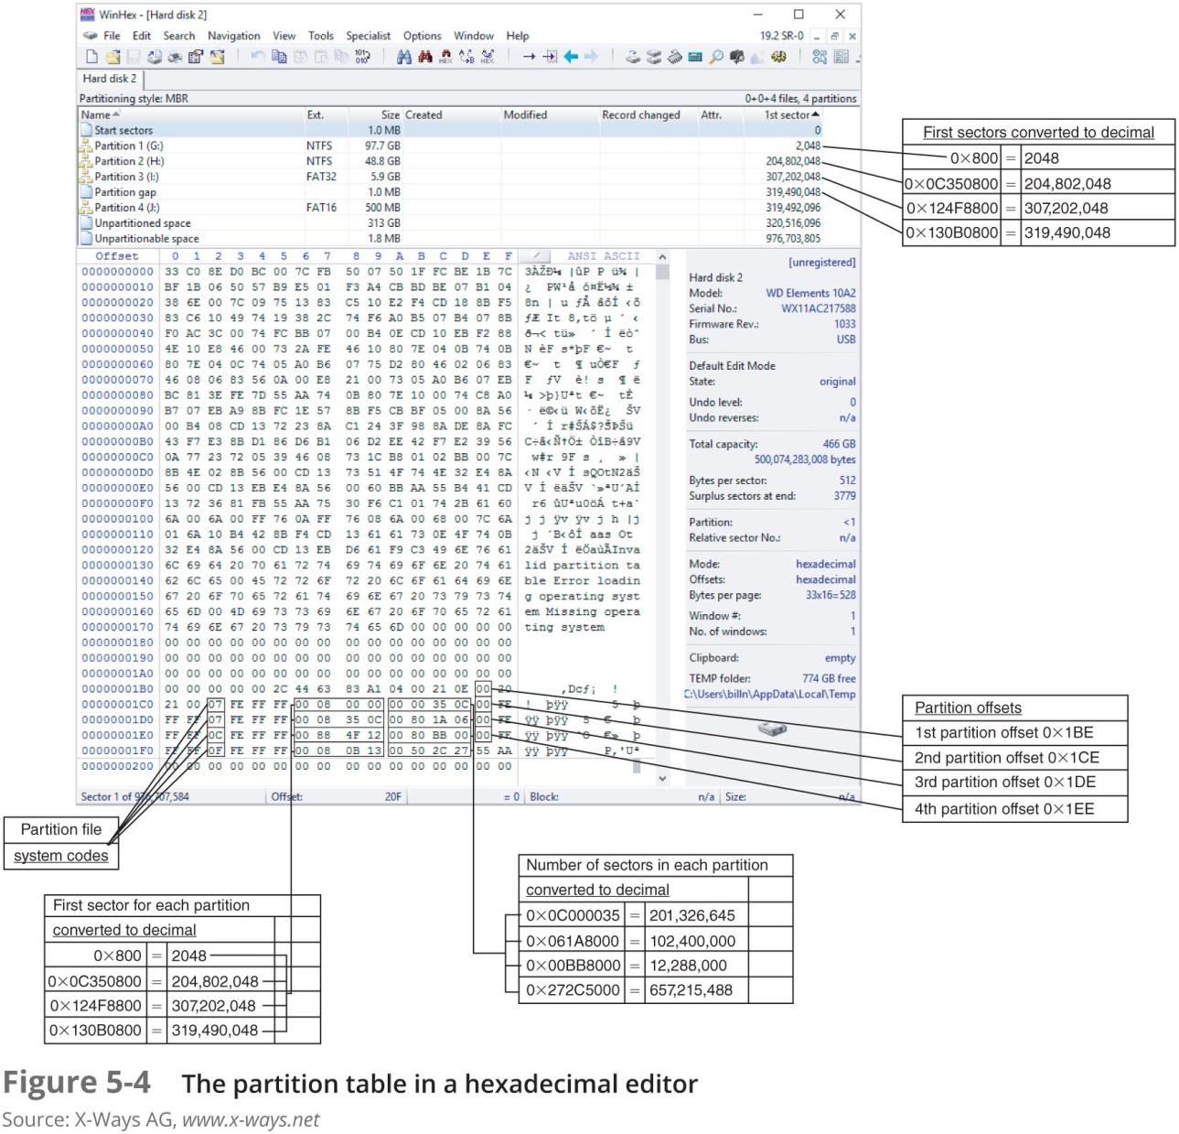
5.3 Examination (contd.)
Disk Partition (MBR)
The partition table in a hexadecimal editor

Slide 19
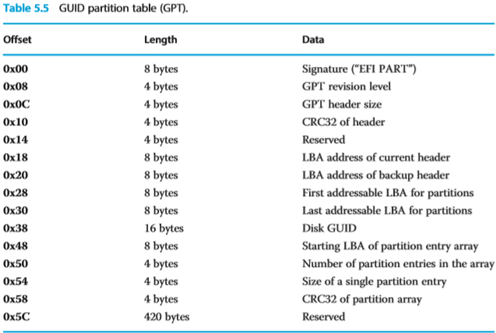
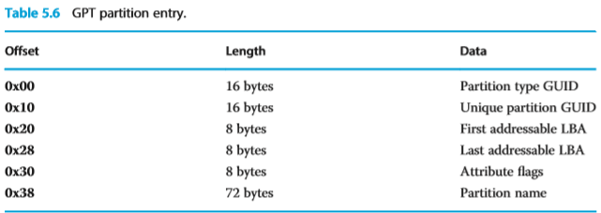
5.3 Examination (contd.)
5.3.1.2.2 GUID Partition Table (GPT)
To address limitations of the MBR partitioning format, GPT schemes were created for using GUIDs (global unique identifiers) to reference each partition; not limiting the number of partitions to a defined set of four.
Using 64 bit LBA (Logical Block Addressing) for storing sector numbers, there by increasing the theoretical maximum disk size; and maintaining backups and CRC32 checksums to detect and fix potential corruption.
The GPT partition scheme reserves absolute sector zero and utilizes the same offset as the MBR uses to describe a partition. This first entry describes the entire disk up to 2 TiB (the maximum size definable in an MBR).
The next sector contains the GPT header and defines the disk contents (Table 5.5 and Table 5.6). Contents include the GUID for the disk, partition table location, maximum number of partitions, and location of the backup header.

Slide 20
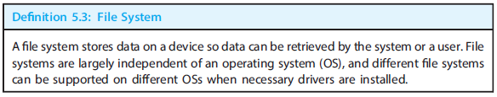
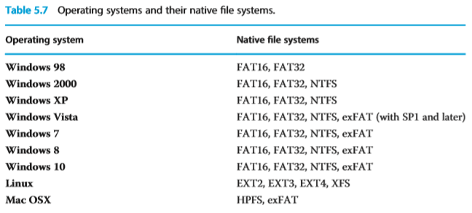
5.3 Examination (contd.)
5.3.2 File Systems
File systems are formatted on to a volume – either a single-partition or a multiple-partition volume in the case of a RAID or an LVM.
Provides a means by which the OS can access the actual files stored on disk (can be thought of as a database in the sense that, like a database, data is stored somewhere on the volume) and metadata is used to track the data.
Modern file systems are largely independent of the OS – Linux can read and write to the Microsoft NTFS, and with the proper drivers, Windows can read and write to Linux EXT (Extended File System).

Slide 21
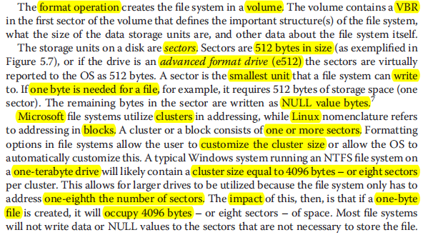
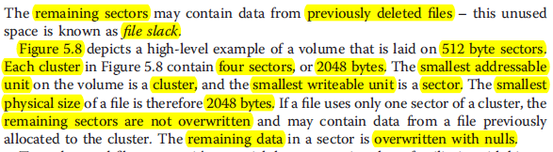
5.3 Examination (contd.)
5.3.2 File Systems (contd.)

Slide 22
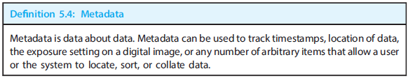
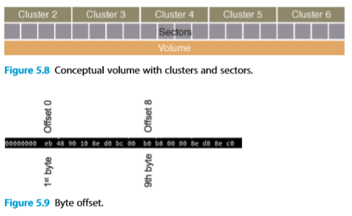
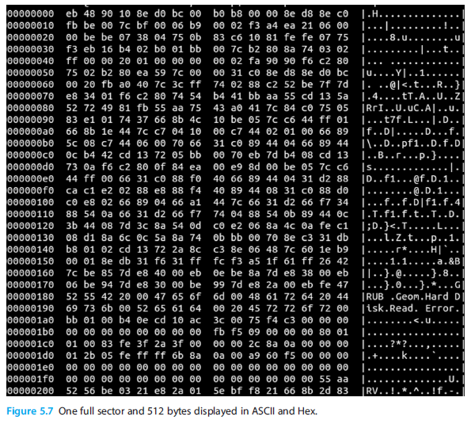
5.3 Examination (contd.)
5.3.2 File Systems (contd.)
Metadata in a file system includes items like a file’s location (or address) and the size of the data so the system can retrieve it from the hardware. It also includes items like a filename and the location of a file in hierarchical directory structures or paths so the user can find the file. Other metadata: Timestamps, Flags (archive, deleted file, read-only, or a directory).

Slide 23
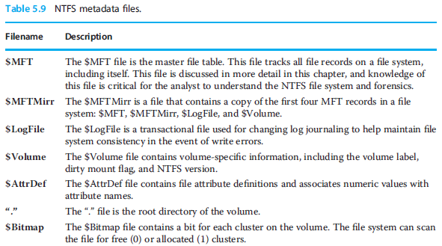
5.3 Examination (contd.)
5.3.2.1 NTFS (New Technology File System)
Most common file system examined in an enterprise environment and continues to be used as the default file system in Windows10.
5.3.2.1.1 Metadata Files: Metadata ﬁles are ﬁles that are generally not directly accessible by the user. They track data required for the ﬁle system to operate and can contain useful forensic information ($MFT in Table 5.9).
5.3.2.1.2 Master File Table (MFT): The MFT is a collection of ﬁle records in an NTFS volume. All objects in the NTFS are tracked in ﬁle records – including ﬁles, directories, and even the VBR.
The MFT is created during formatting of a volume.
The file system determines a place to allocate the MFT on the physical media and provides efficient access time, and decreases the fragmentation.
The location of the MFT on the volume is defined in the VBR.

Slide 24
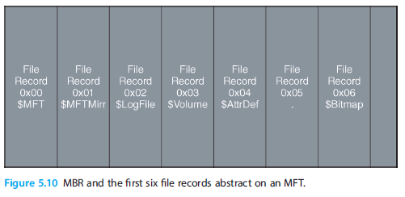
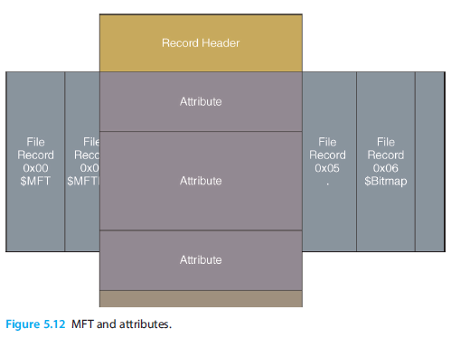
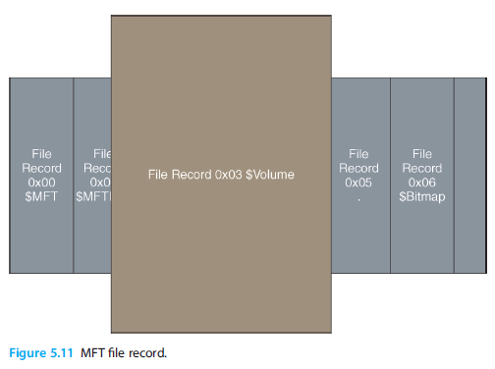
5.3 Examination (contd.)
5.3.2.1.3 MFT File Records:
The MFT consists of sequential MFT file records. While file record size is defined in the VBR, in practice these are 1024 bytes (1KB).
The MFT ﬁle records consist of an MFT record header that deﬁnes the ﬁle record as well as a series of attributes that deﬁne data about a ﬁle or directory.

Slide 25
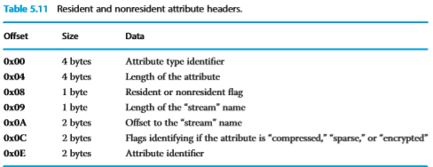
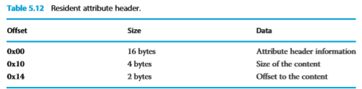
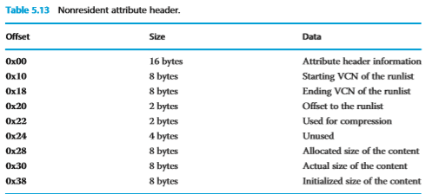
5.3 Examination (contd.)
5.3.2.1.4 Attributes:
Attributes track metadata about specific structures in an MFT record that include the data, directory content, file time stamps, file name, security information, and more.
Required attributes: the standard information attribute and file name attribute, and either a data attribute or an index root attribute.
Each attribute begins with a header that describes the attribute’s physical size and how to find the content of the attribute.
The content of an attribute can be resident (files <1024 bytes) or nonresident ( files larger than 1024 bytes). The standard information attribute, file name attribute(s), and index root attributes are required to be resident.

Slide 26
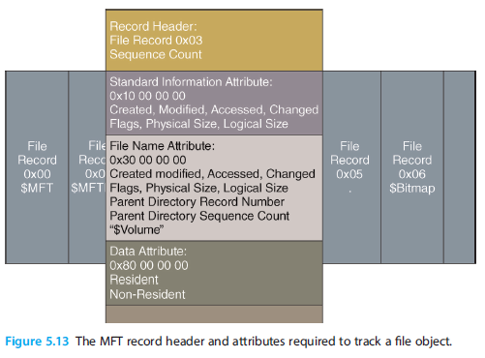
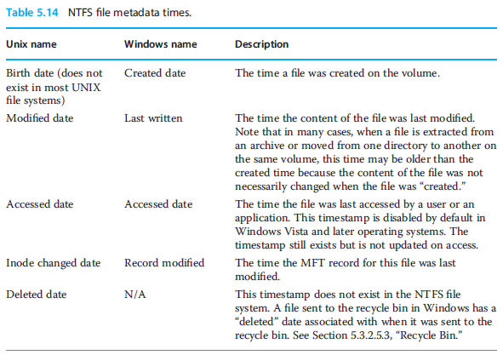
5.3 Examination (contd.)
5.3.2.1.4 Attributes (contd.):
To track a file on an NTFS file system, at minimum the file system needs the file record header along with the standard information attribute, at least one file name attribute, and the data attribute. (Figure 5.13)
Standard Information Attribute: MAC (modiﬁed, accessed, changed) times were originally derived from the three UNIX ﬁle system timestamps – ﬁle content Modiﬁed, ﬁle last Accessed, and inode Changed time.
Various tools and Oss often refer to these times differently. Table 5.14 provides a comparison of UNIX MAC file time descriptions to Microsoft Windows file time descriptions.

Slide 27
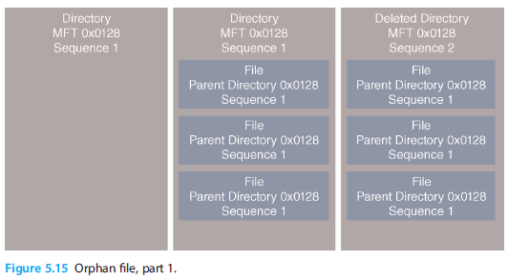
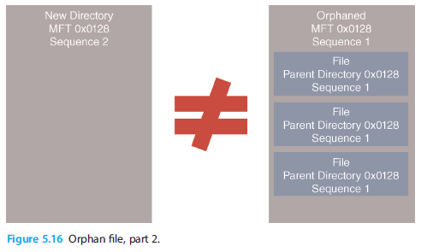
5.3 Examination (contd.)
5.3.2.2 INDX (Index)
INDX records can be sources of evidence even if the directory has been deleted. NTFS does not immediately overwrite content, so if a directory has been deleted, the INDX records(content of an index attribute) can still be located on disk.
The index always starts with INDX and records that have not been overwritten can be carved with tools – or even viewed with a hex editor.
5.3.2.3 Orphan Files
Files whose parent directory has been deleted and whose MFT record is overwritten are known as orphan ﬁles or lost ﬁles. (Figure 5.15 & 5.16)
If the files’ records were not overwritten, the Metadata for the files is recoverable and the file data may also be recovered.

Slide 28

5.3 Examination (contd.)
5.3.2.4 EXT2/3/4 (Second, Third, and Fourth Extended File systems)
Most common file system supported natively by Linux distributions (EXT2, EXT3 & EXT4)
An inode (index node) is used in EXT file systems to track metadata for files and directories (Def 5.8)
Data for a file or directory is stored in blocks, smallest addressable allocation unit on an EXT file system. (1, 2, 4, or 8 KB, default block size 1 KB).
Directory entries in EXT file systems contain the file name length, the file name itself, and the inode number of the file.
5.3.2.4.1 Deleted Files: EXT2 files can be recovered by using the foremost or debugfs programs, and by searching for deleted files in the inode tables. EXT3 and EXT4 files may be possible to recover by using ext3grep and the EXT3 or EXT4 file system journal.
5.3.2.4.2 Lost Files: If the file system becomes corrupt and a directory entry is deleted, but not the associated inode, the file still may be recoverable and the file system will place these into the lost+found directory with the inode number as the filename similar to the NTFS orphan files operation.
5.3.2.4.3 Journaling: EXT3 and EXT4 are both journaling file systems that act much like database transaction fault tolerance with data integrity. It functions to store data in a journal until an act –such as writing a file – is completed.

Slide 29
Thank You!

